Slide 1
Data Visualization ACE 592 SAE

Slide 2
Back to Data Visualization
We’ve gone over data visualization in the course quite a bit already.
Now that we have done a bit of exploring and are more comfortable with Python, we can dive it to some general principles of making graphs.

Slide 3
What are the goals of data visualization?

Slide 4
What are the goals of data visualization?
Tell a story!
Requires you to think carefully about what sort of story you are telling.
What do you want to tell your audience in one sentence?

Slide 5
What are the goals of data visualization?
Tell a story!
Requires you to think carefully about what sort of story you are telling.
What do you want to tell your audience in one sentence?
Succinctly summarize data.
Tables sometimes do not intuitively communicate results.
Our brains are geared to sometimes take in information visually.

Slide 6
The Cardinal Sins of Data Visualization
What are some?

Slide 7
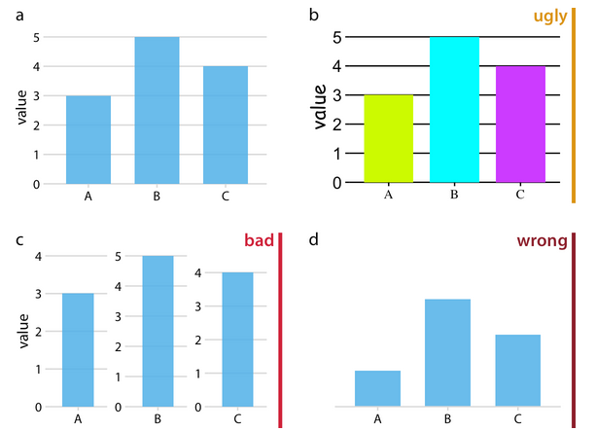
The Cardinal Sins of Data Visualization
From the book Fundamentals
of Data Visualization:
Ugly: bad colors or aesthetically displeasing elements.
Bad: not incorrect, but actively misleading.
Wrong: contains incorrect information.

Slide 8
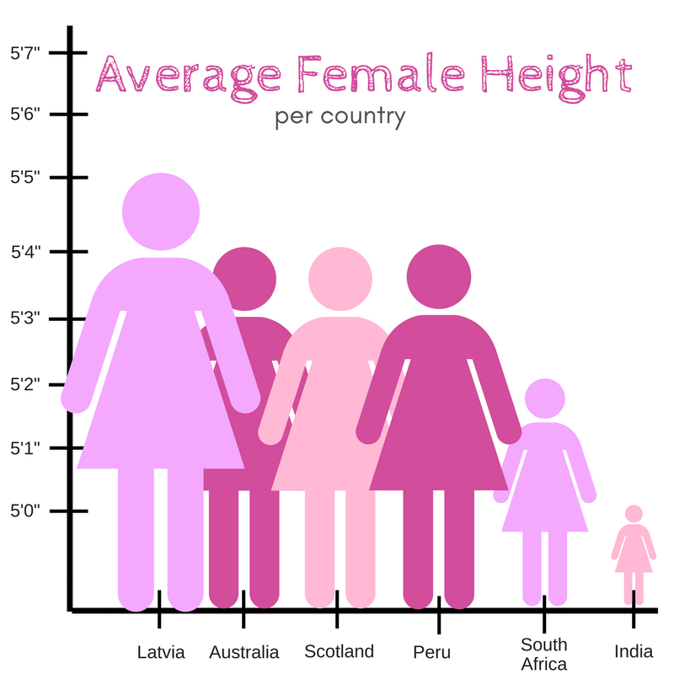
Categorizing Bad Graphs: Good, bad, ugly, or wrong?

Slide 9
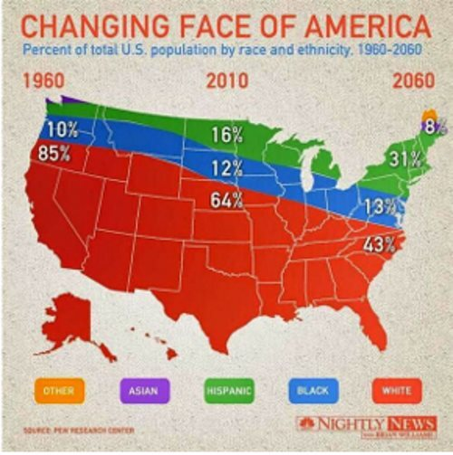
Categorizing Bad Graphs: Good, bad, ugly, or wrong?

Slide 10
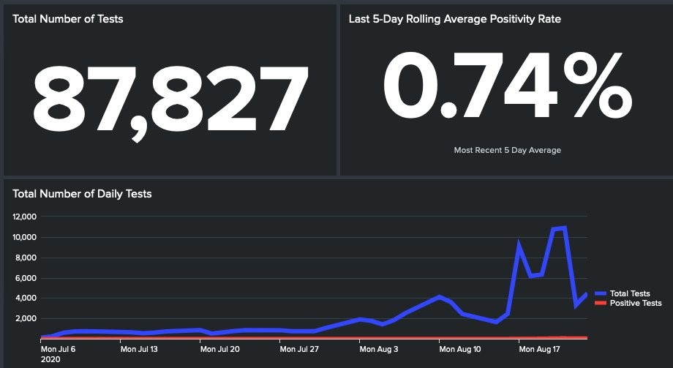
Categorizing Bad Graphs: Good, bad, ugly, or wrong?

Slide 11
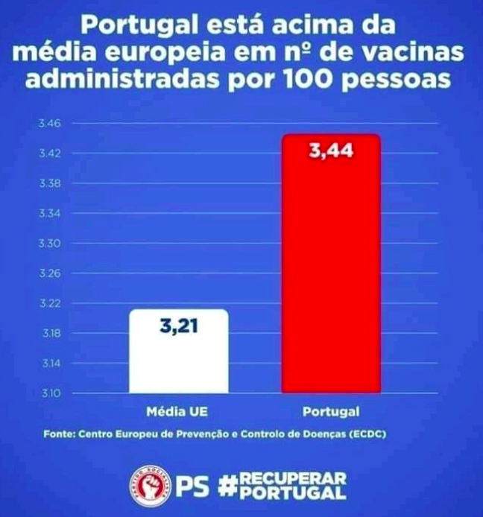
Categorizing Bad Graphs: Good, bad, ugly, or wrong?

Slide 12
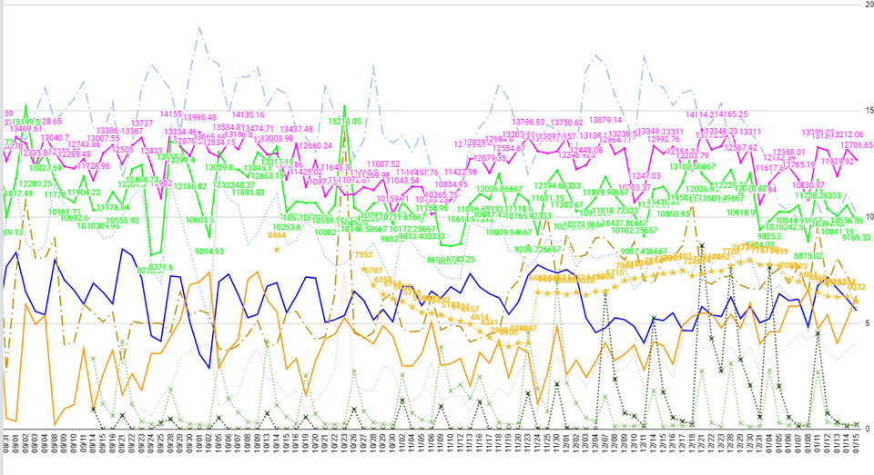
Categorizing Bad Graphs: Good, bad, ugly, or wrong?

Slide 13
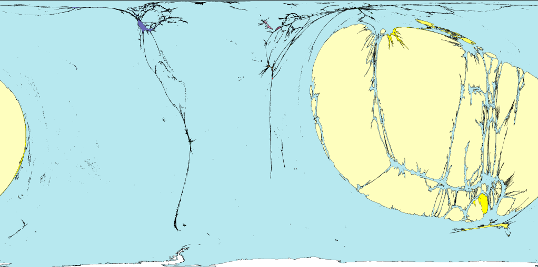
Categorizing Bad Graphs: Good, bad, ugly, or wrong?

Slide 14
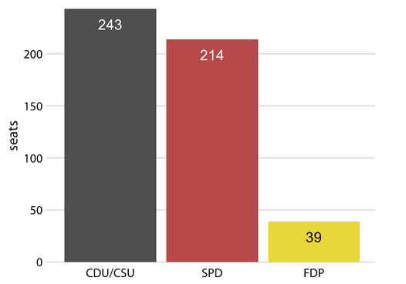
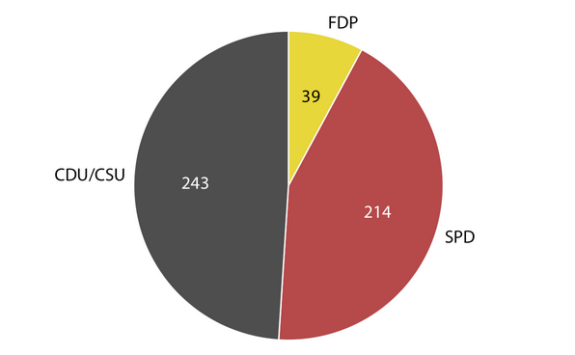
Principles of Good Visualization
Use graph types that are appropriate for the type of data.
Example: visualizing proportions should usually be done with a pie chart instead of a bar chart.

Slide 15
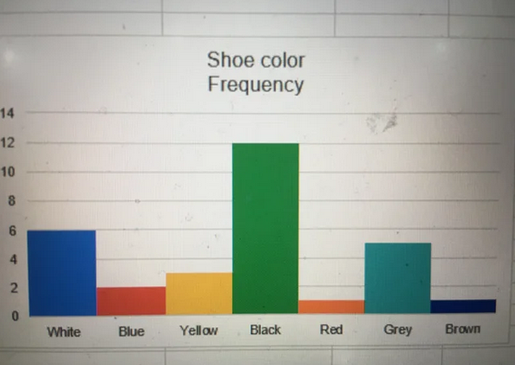
Principles of Good Visualization
2. Colors should be intuitive and meaningful.
Does darker mean higher values? Lower values?
Does green = good? Does red = bad?

Slide 16
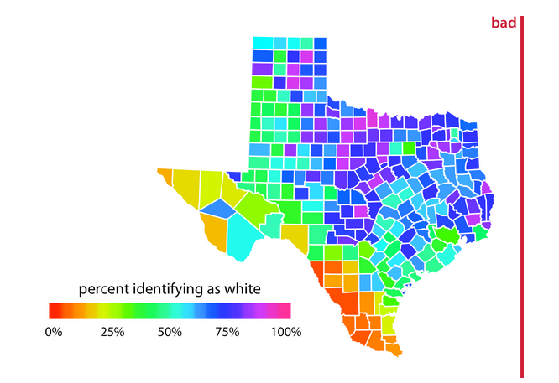
Principles of Good Visualization
2. Colors should be intuitive and meaningful.
Is the colormap diverging because there is a point of divergence?
If the colormap is a spectrum can the variable be interpreted on a spectrum?

Slide 17
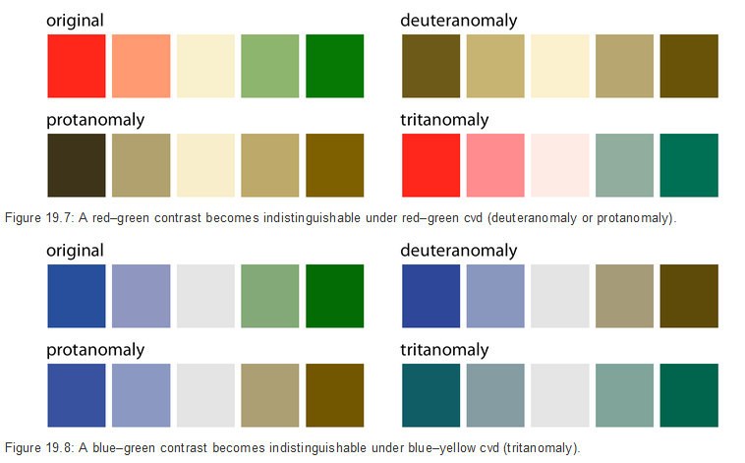
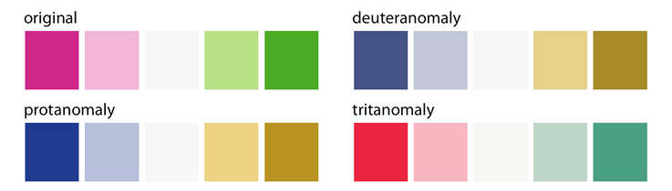
Principles of Good Visualization
2. Colors should be intuitive and meaningful.
Can someone who is colorblind determine your values?
Are you using appropriate color maps?

Slide 18
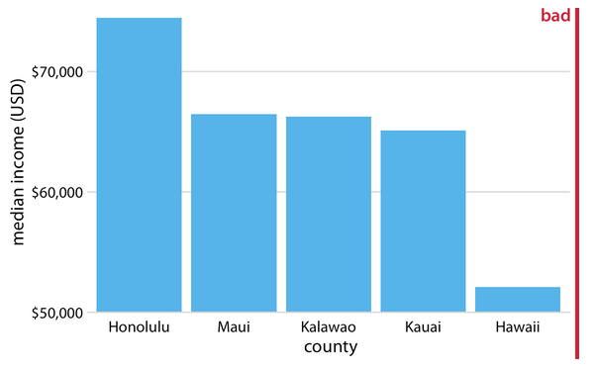
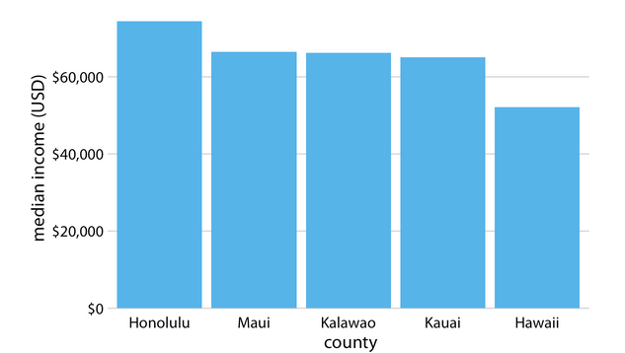
Principles of Good Visualization
3. The Proportional Ink Principle: the amount of ink you use should reflect its value
Our eyes tend to interpret graphs this way.
Linear axes should always start from 0; log axes should start from 1.

